Slide 1




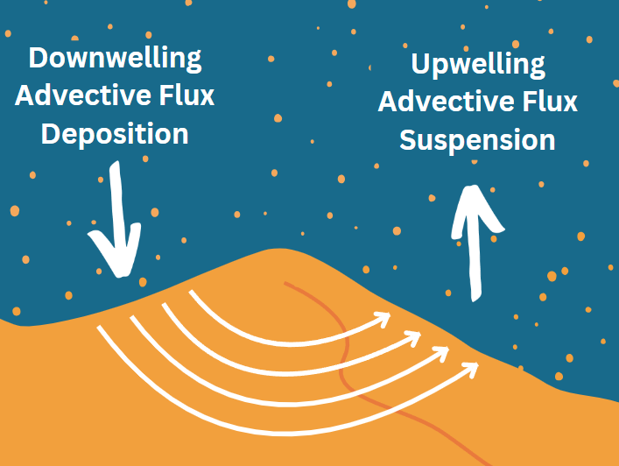
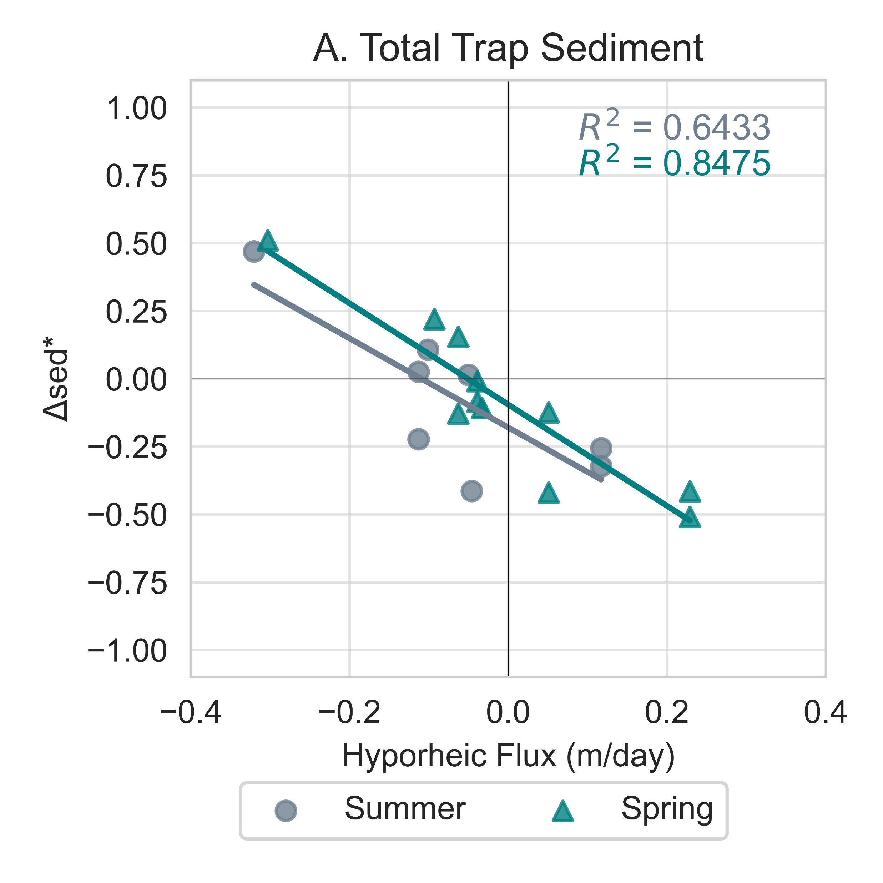
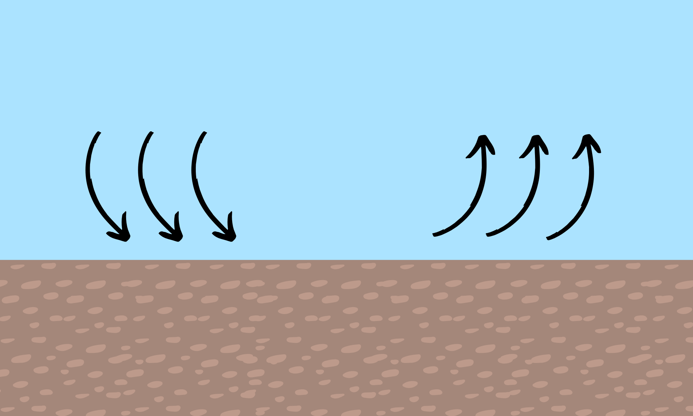
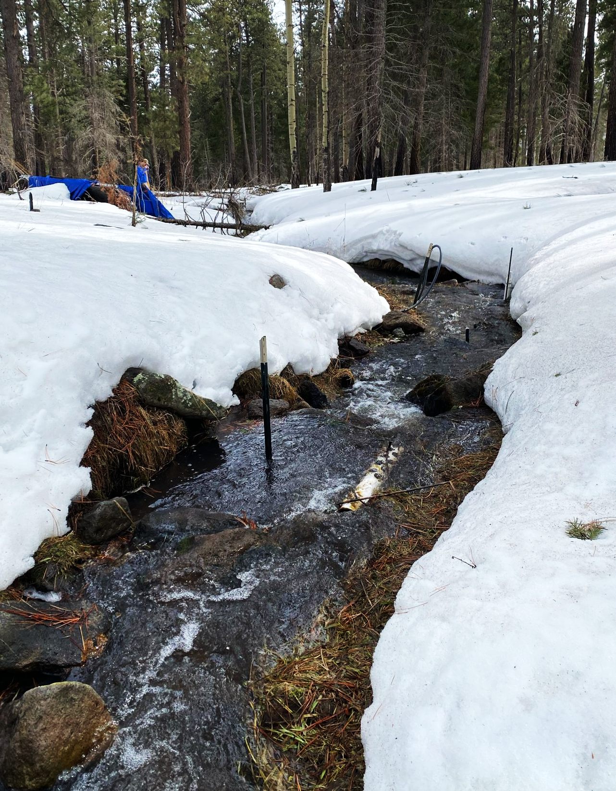
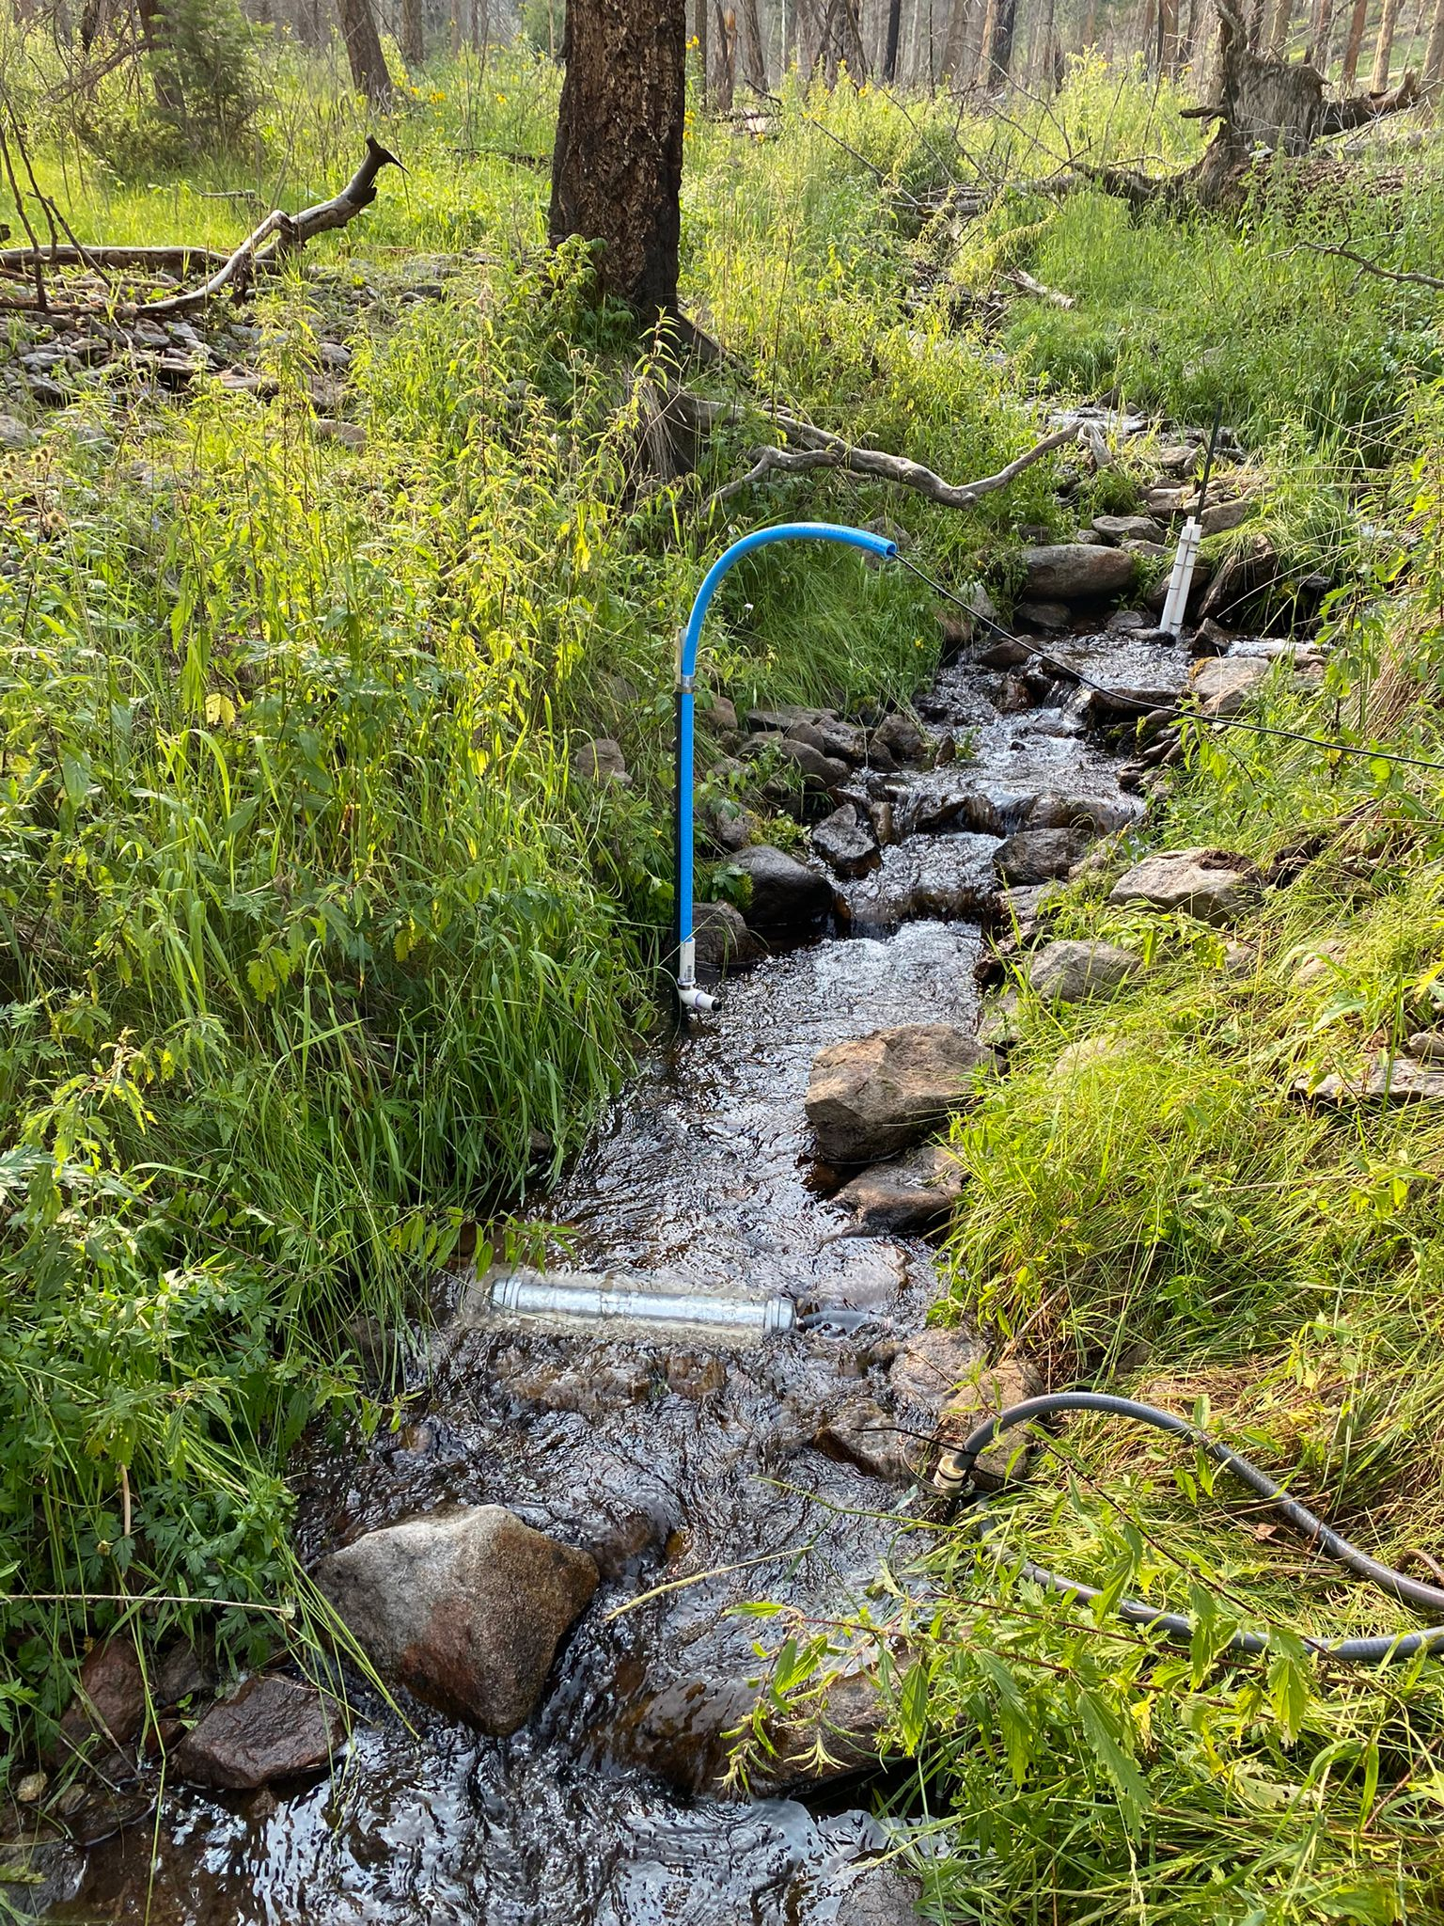
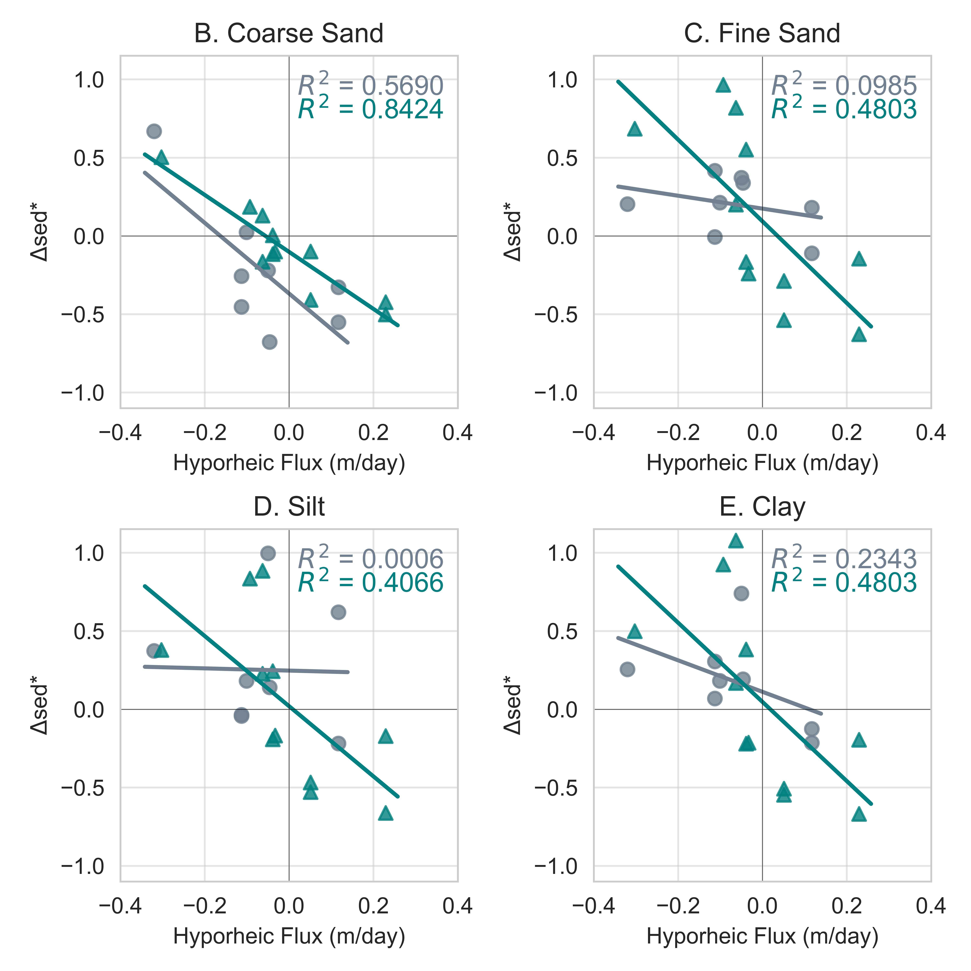
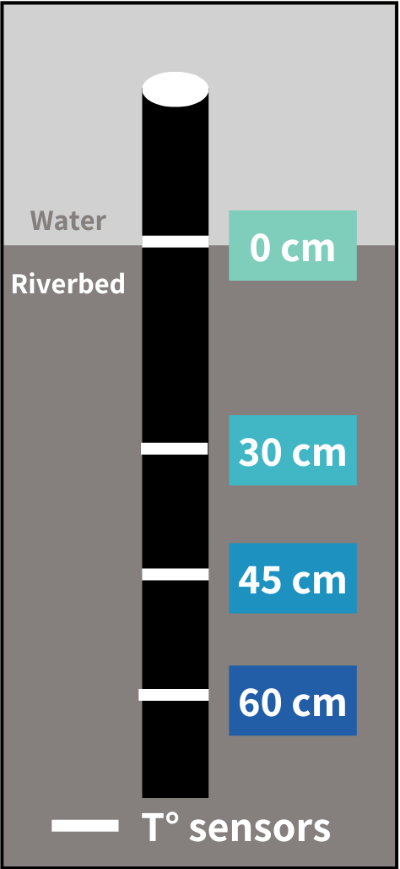
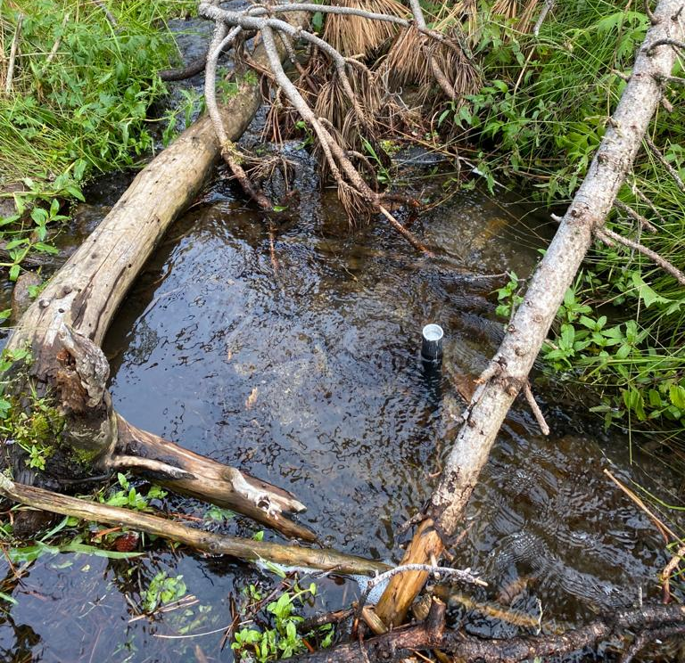
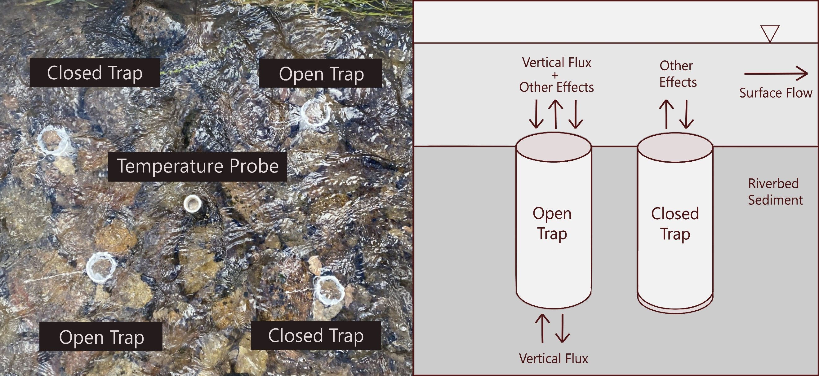
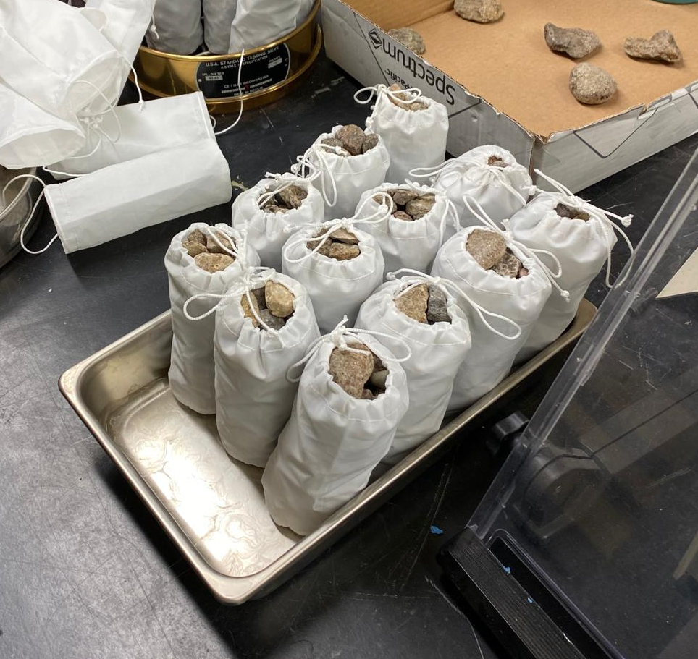
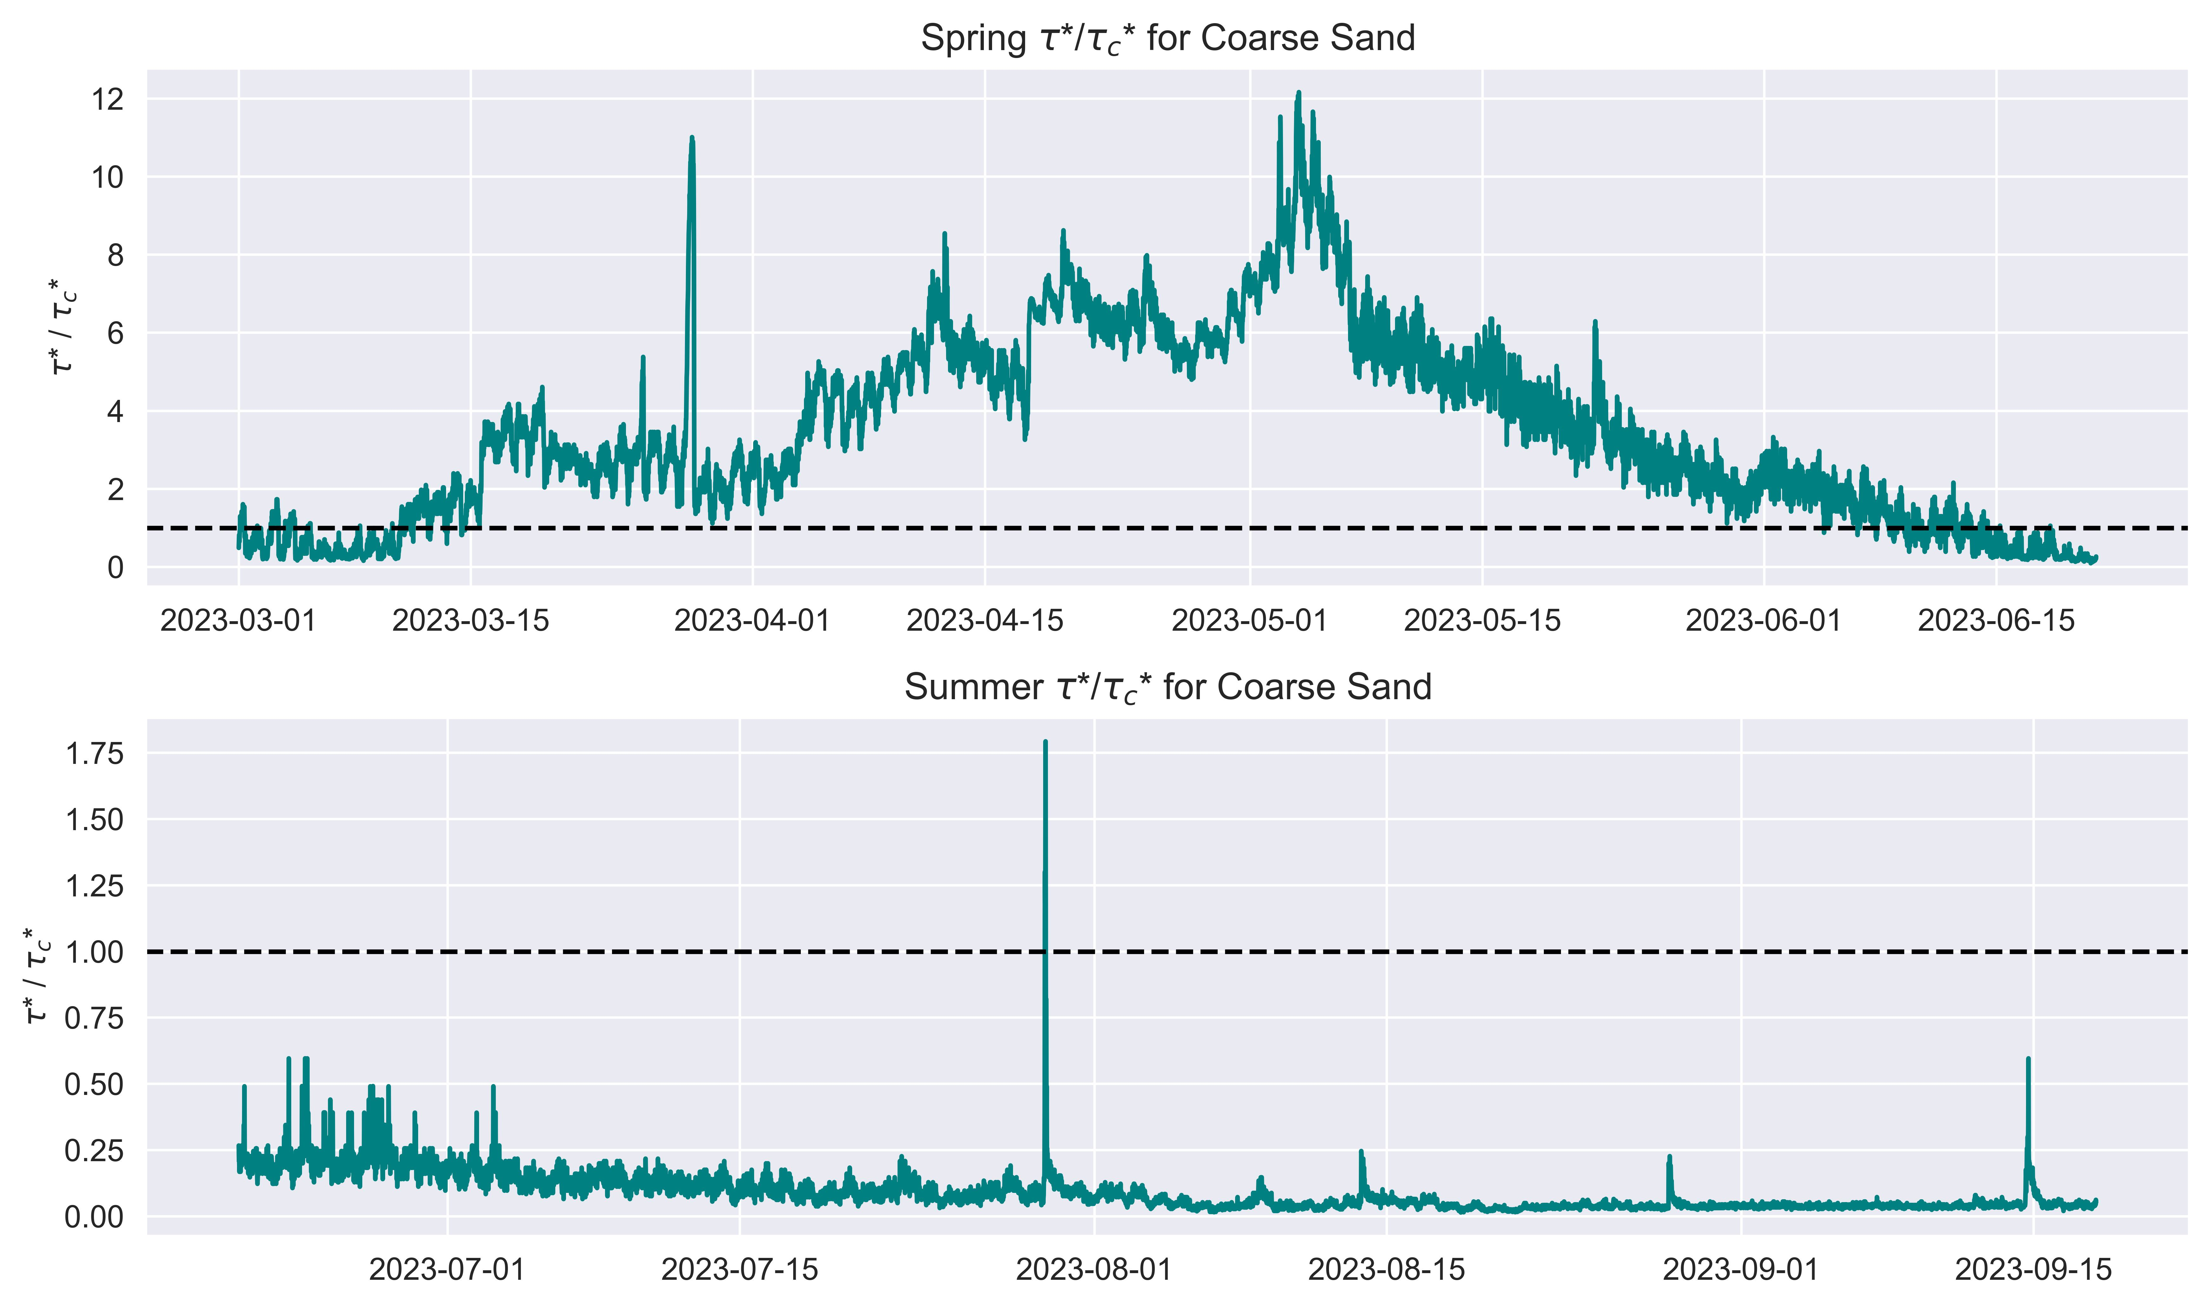
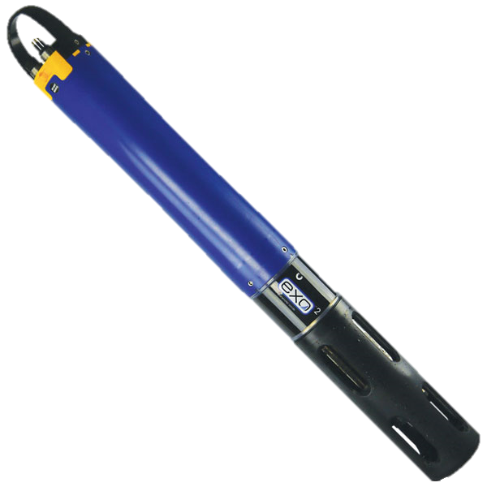
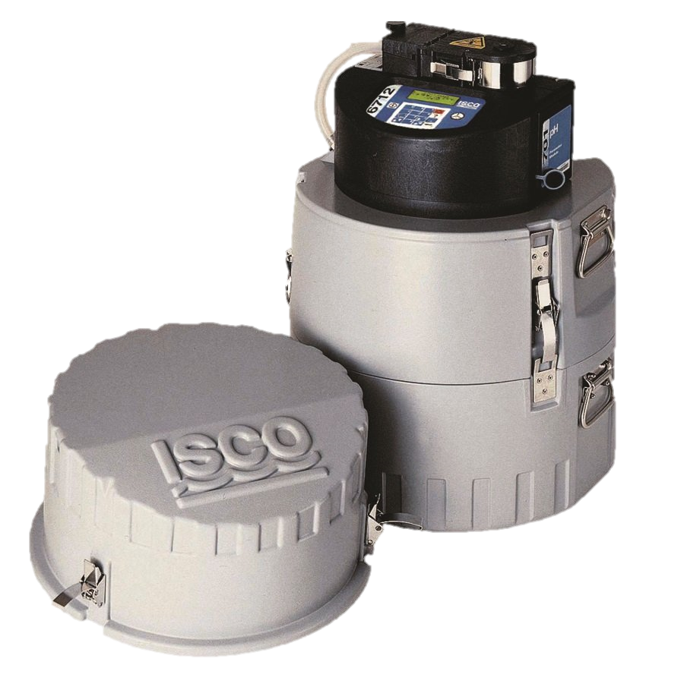
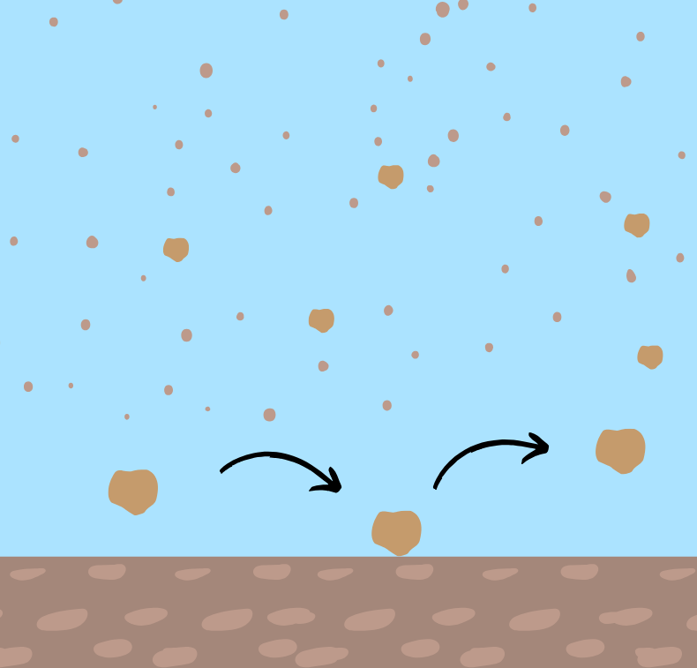
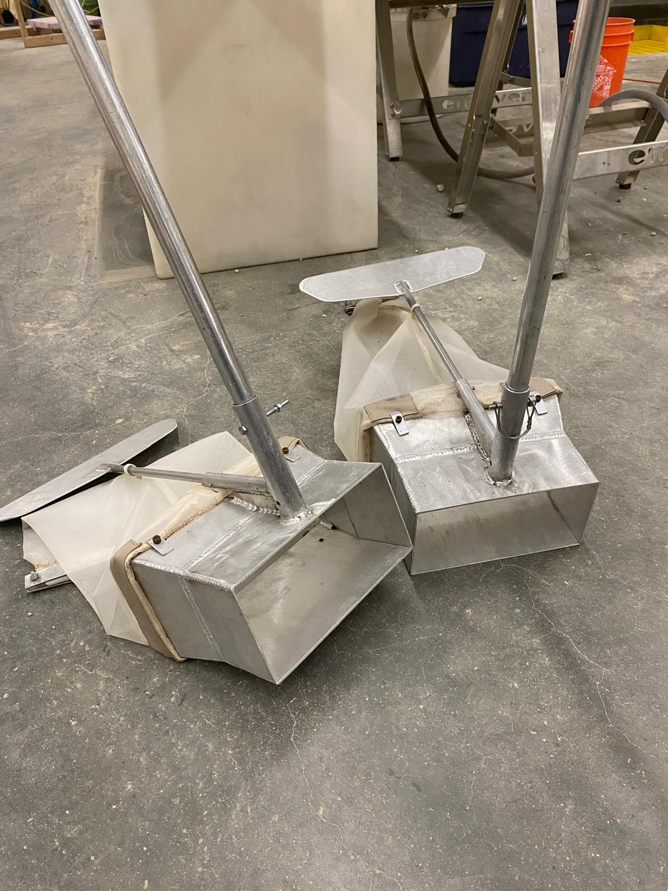

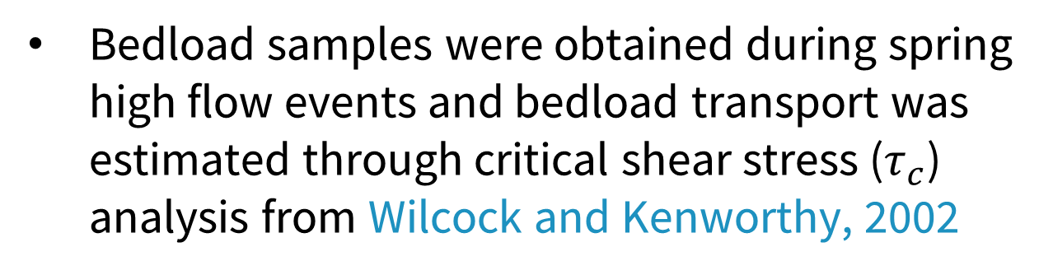


Flux-Driven Deposition: The Influence of Vertical Hyporheic Flux Direction and Magnitude on Fine Particle Deposition
Nicole Hucke^{1*}, Elowyn Yager¹, Andrew Tranmer¹, Janice Brahney², Joel Rowland³
¹University of Idaho, Boise, ID
²Utah State University, Logan, UT
³Los Alamos National Laboratory, Los Alamos, NM
Environmental System Science Program
Calculated the normalized difference in sediment mass between open and closed traps to isolate the contribution of vertical hyporheic flux to deposition.
Background and Motivation
Results
Total Trapped Sediment .
Hyporheic flow - the movement of water through subsurface fluvial sediments - is vital for aquatic ecosystems by supporting nutrient cycling and solute transport.
Fine sediment (sand, silt and clay) deposit onto the riverbed after high flow events due to gravitational settling and turbulence.
Downwelling (negative VHF) increases deposition in open traps — ∆sed* is positive, as water carries sediment into the bed.
Near-zero exchange (neutral VHF) results in similar deposition between open and closed traps — ∆sed* is close to zero.
Upwelling (positive VHF) reduces deposition in open traps — ∆sed* becomes negative, as water moves sediment out of the bed.
Wo > Wc
Deposition can also be influenced by vertical hyporheic flux (VHF) but has mostly been studied for silt in clay and in sand-bedded channels and less is known about how VHF influences sand in steep, coarse mountain streams.
Wo < Wc
Research Questions:
Coarse Sand (0.2 – 2 mm)
Fine Sand (0.02 – 0.2mm)
Silt (0.002 – 0.02 mm)
Clay (< 0.002 mm)
Downwelling
Upwelling
What role does vertical hyporheic flux play in fine sediment deposition compared to other processes?
How do downwelling and upwelling fluxes influence the transport and storage of different grain sizes in mountain streams?
In extreme cases, ∆sed* values reached ±0.5, meaning VHF increased or decreased sediment deposition by up to 50%.
Methods
Field campaigns during 2023 spring snowmelt high flows and summer monsoon storms were conducted to capture sediment transport, deposition, and local hyporheic fluxes.
Trapped Sediment by Grain Size Class .
Coarse sand showed the strongest relationship with VHF, out of all grain sizes for both spring (R² = 0.85) and summer (R² = 0.64).
Spring had significant relationships between ∆sed* and VHF for all grain sizes, while summer showed no significant patterns for fine sand, silt and clay.
These sediment relationships may result from overall differences in total sediment deposition between spring and summer, independent of hyporheic flux.
Study Site: La Jara Creek,
Valles Caldera National Preserve, NM
1. Measuring Vertical Hyporheic Flux:
Channel slope: 8-10% and width: 1 m
Installed seven temperature-based flux probes along the channel to record data every 15 minutes. Probes measure temperature at multiple depths to estimate vertical exchange between surface water and the riverbed.
Spring traps collected more total sediment than summer traps.
This difference was driven by higher coarse sand deposition in spring, while finer sediments (fine sand, silt, clay) dominated in summer.
iFLOW (Bertagnoli, et al., 2024) to calculate advective flux using temperature record of the probes, focusing on the top 30 cm.
Lastly, we calculated seasonal average flux magnitude during active sediment transport to represent VHF at each probe.
On average, spring traps had 180% more coarse sand and 56% less fine sediment by weight compared to summer.
This matched water column grain size distributions, where lower concentrations of fines were available in spring compared to summer.
2. Measuring Sediment Deposition:
Deployed paired sediment traps (open-bottom and closed-bottom) at each flux probe location. Open-bottom traps allowed hyporheic exchange; closed-bottom traps blocked it to isolate deposition from other processes.
Traps collected sediment in fine-mesh bags and coarse gravel matrix over the full season, representing the seasonal average deposition at each site.
Higher coarse sand deposition in spring and better coarse sand ∆sed* and VHF relationship: Bedload transport
Spring flows were high enough to mobilize coarse sand as bedload and regularly exceeded the critical shear stress ($τ_{c}$*=0.867), while summer flows rarely did.
Bedload support this, with spring samples being ~49% coarse sand and 21% gravel
Stronger coarse sand–VHF correlations suggest bedload is responsive to VHF due to sustained riverbed contact.
Hyporheic…
Overall better relationships in spring than in summer: Time in Suspension
$$∆{sed}^{∗}= \frac{W_{o}−W_{c}}{W_{c}}$$
Calculated the normalized difference in sediment mass (Δsed*) between open and closed traps to isolate the contribution of vertical hyporheic flux to deposition.
Spring sediment stayed suspended ~9x longer, increasing chances of VHF interaction with the water column and driving sediment deposition of all sizes.
Summer short storm durations limited VHF influence, causing worse relationships.
Lower shear-to-settling ratios for summer concentrated fine sediment near the bed, enhancing deposition amounts independent of VHF.
$W_{o}$: Sediment weight in open traps
$W_{c}$ : Sediment weight in closed traps
3. Water Column Sediment and Bedload Transport:
Deployed a turbidity sensor and ISCO samplers to collect water samples and monitor suspended sediment. Grain size distributions were obtained using a LISST portable XR laser diffraction instrument.
Turbidity
Main Findings and Conclusions
YSI EXO2 Sonde
Vertical hyporheic flux (VHF) alters sediment deposition by up to 50%. Downwelling enhances deposition while upwelling reduces it.
Longer sediment suspension times will allow longer water column and VHF interaction, enhancing the relationship between ∆sed* and VHF.
Coarse sand being transported as bedload can be affected by VHF as it is closer to the riverbed interface and is readily exposed to VHF.
Our findings are one of the first demonstrations of the relative contribution of VHF to sediment deposition compared to other effects in mountain streams.
Suspended Sediment
Portable ISCO samplers
Sand in suspension
Bedload samples were obtained during spring high flow events and bedload transport was estimated through critical shear stress ($τ_{c}$) analysis from Wilcock and Kenworthy, 2002
Sand as bedload
Student Award Poster

